Slide 1
Aggregating evidence, cost-effectiveness, and generalizability
Class 17
EDUC 157: Educational Research and Evaluation
UCI School of Education

Slide 2
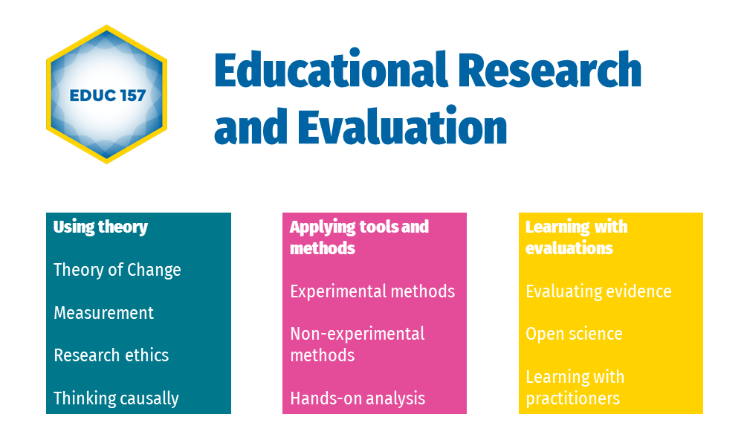

Slide 3
Plan for today
Meta-analysis
Cost-effectiveness analysis
The ‘generalizability framework’

Slide 4
Meta-analysis

Slide 5
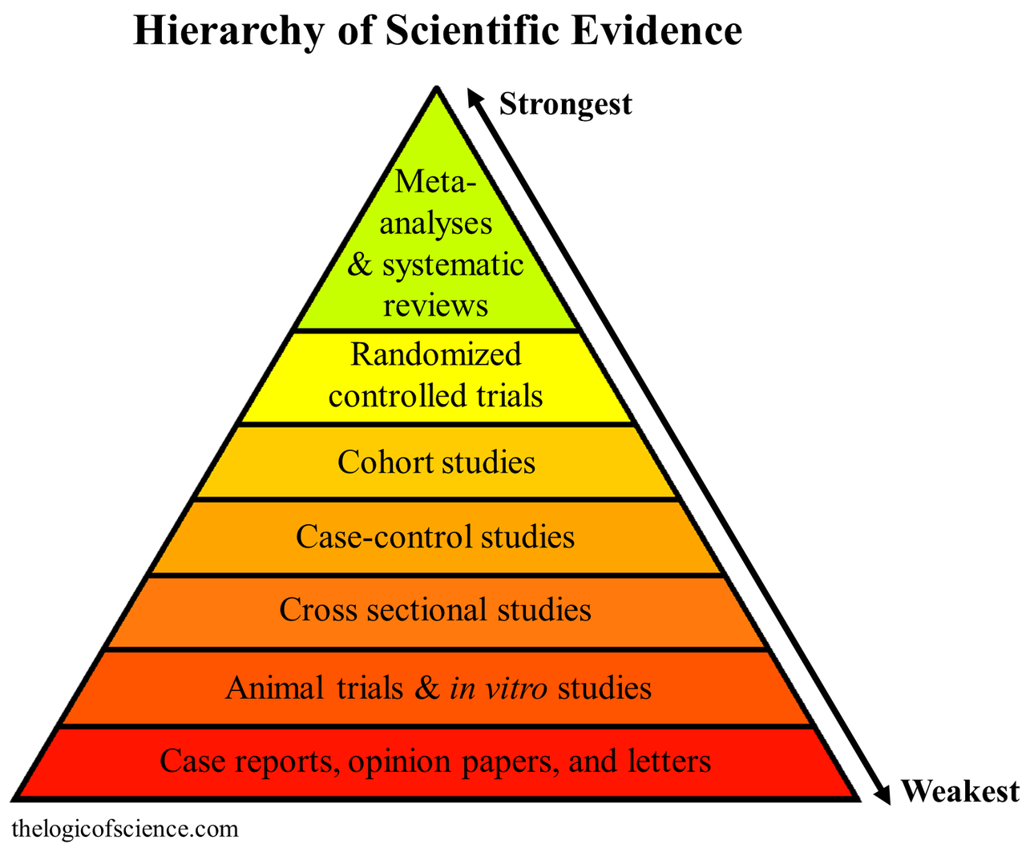
Wikipedia says…
“A meta-analysis is the highest form of knowledge in science”

Slide 6
Intuition
The results from 2 excellent RCTs > The results from 1 excellent RCT. So, …

Slide 7
The question
If we have more than one valid study for the same population and for the same intervention, then how can we aggregate the effects?

Slide 8
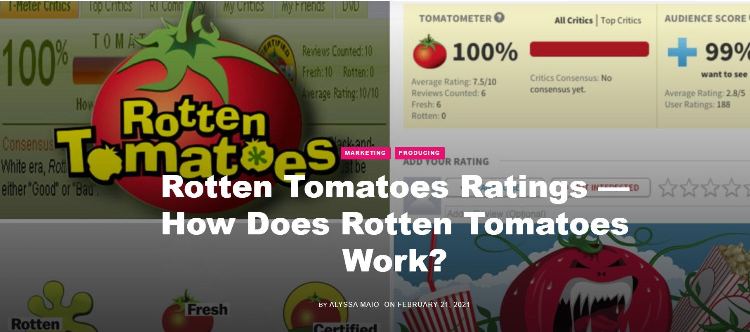

Slide 9
What would a “Rotten Tomatoes” of studies on the effectiveness of remediation programs on student learning look like?

Slide 10
We can do much better than “Certified Fresh”
Rotten Tomatoes
Literature review
Meta-analysis
Yey / ney review
“Yey / ney review”
Causal estimates
Average “yey” = “fresh”, “rotten”
Unstructured synthesis
Average effect
More than 80 reviews: “certified”
Larger sample: greater precision
Uncommon findings: greater weight

Slide 11
Averaging treatment effects
Stratified trial
Meta-analysis
Average treatment effect (causal)
Average treatment effect (causal)
Multiple sites, strata
Multiple studies
Larger strata: more weight
Larger studies: more weight
Fixed or random effects
Fixed or random effects
Same intervention
Same intervention?
Same measures
Same measures?
Population?
Population?

Slide 12
How to conduct a meta-analysis
1. Research question
2. Search criteria
3. Selection criteria
4. Extraction / coding
5. Modeling, analysis
Intervention-focused
Search terms, keywords
Measurement
Effect sizes, standard errors
Fixed vs. random effects
Outcome-focused
Search engines
Causal identification
Study characteristics
Meta-regression
Both
Language
Quality criteria
Bias plots
Journals
Participant characteristics
Publication status
Geographic scope, time

Slide 13
Meta-analysis toolkit
1. Research question
2. Search
3. Organize
4. Extraction / coding
5. Modeling, analysis
Google Scholar
Zotero
Meta-analysis in R
connected papers.com
elicit.org
UCI Library
Notes:
https://bookdown.org/MathiasHarrer/Doing_Meta_Analysis_in_R/

Slide 14
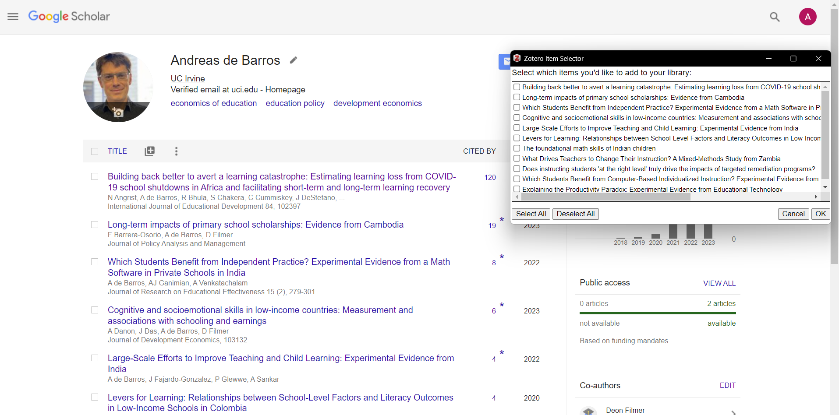

Slide 15
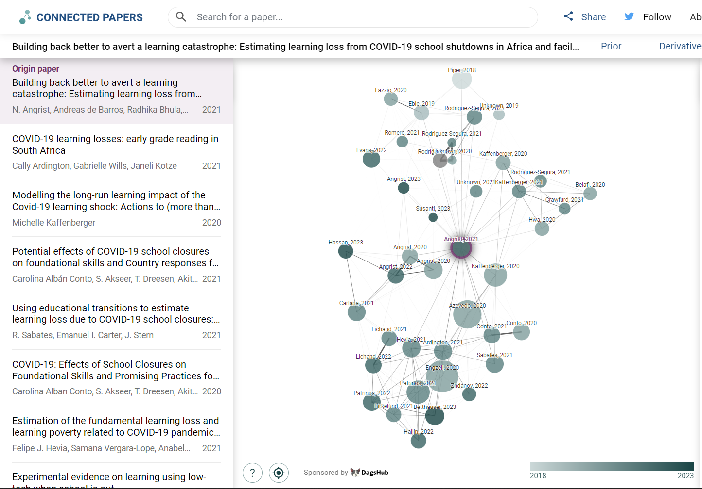

Slide 16
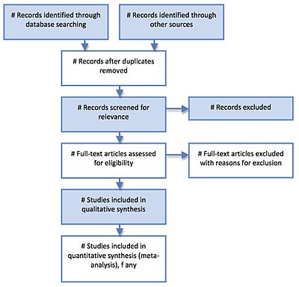
Search and select: The PRISMA statement
PRISMA: Preferred Reporting Items for Systematic Reviews and Meta-Analyses

Slide 17
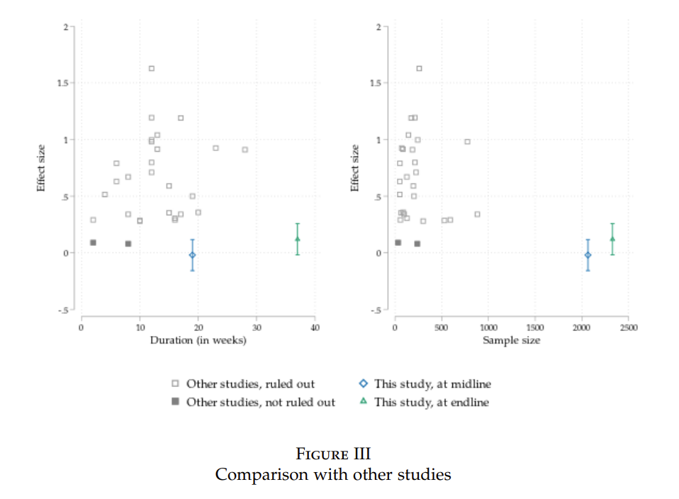
Not quite a meta-analysis
Notes:
Andreas de Barros, Johanna Fajardo-Gonzalez, Paul Glewwe, Ashwini Sankar, The Limitations of Activity-Based Instruction to Improve the Productivity of Schooling, The Economic Journal, 2023;, uead099, https://doi.org/10.1093/ej/uead099

Slide 18
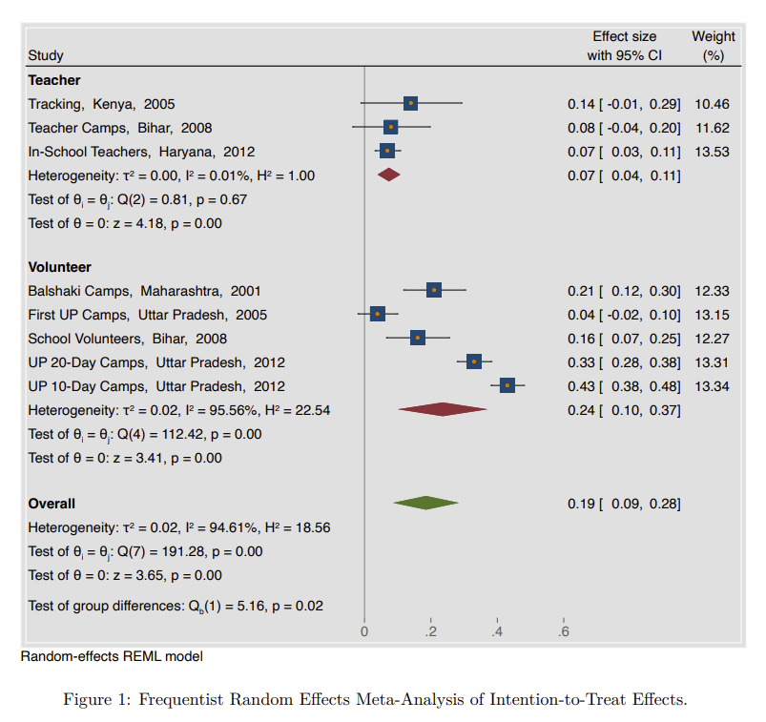
How to read a meta-analysis
Notes:
Source: https://www.edworkingpapers.com/sites/default/files/ai23-802.pdf

Slide 19
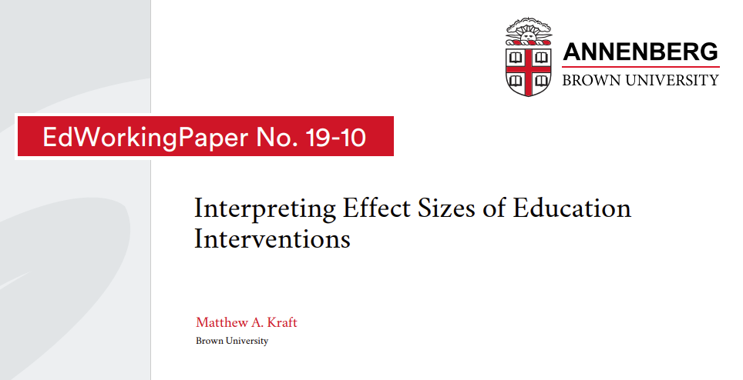

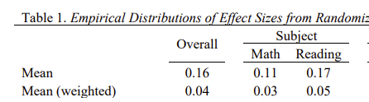
What’s a “big” effect?
Notes:
Source: https://www.edworkingpapers.com/sites/default/files/ai23-802.pdf

Slide 20
Finding meta-analyses, systematic reviews
Academic journals
“Aggregators”
Review of Educational Research
What Works Clearinghouse
Educational Research Review
Campbell Collaboration
3ie
Edu. Endowment Foundation (EEF)

Slide 21
“Meta-analysis is a sausage factory that uses sausages by other factories as inputs.” Uri Simonsohn
Notes:
https://egap.org/resource/10-things-to-know-about-conducting-a-meta-analysis/

Slide 22
Cost-effectiveness analysis

Slide 23
Intuition
One intervention creates a 0.2SD impact for $100 per student > Another intervention creates a 0.2SD impact for $1000 per student So, …

Slide 24
The question
If we have multiple interventions that create differently-sized impacts on the same outcome at different costs, then how can we rank these interventions?

Slide 25
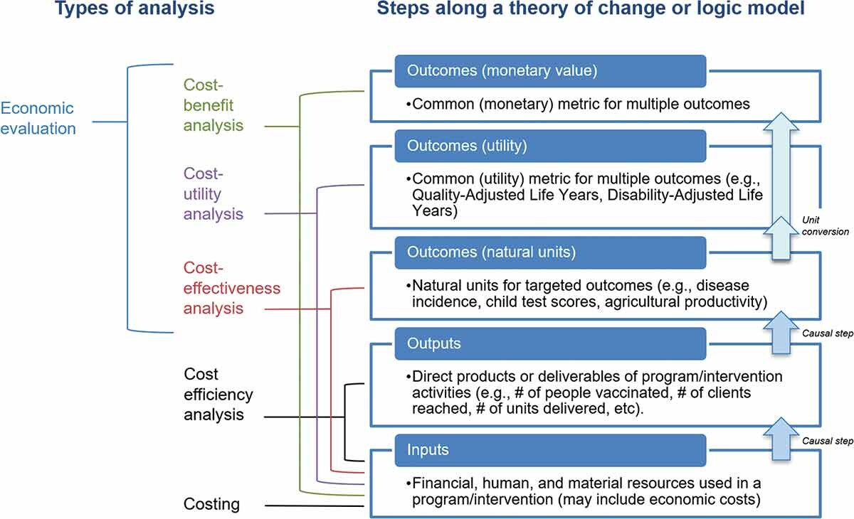
Notes:
https://www.tandfonline.com/doi/full/10.1080/19439342.2022.2034916

Slide 26
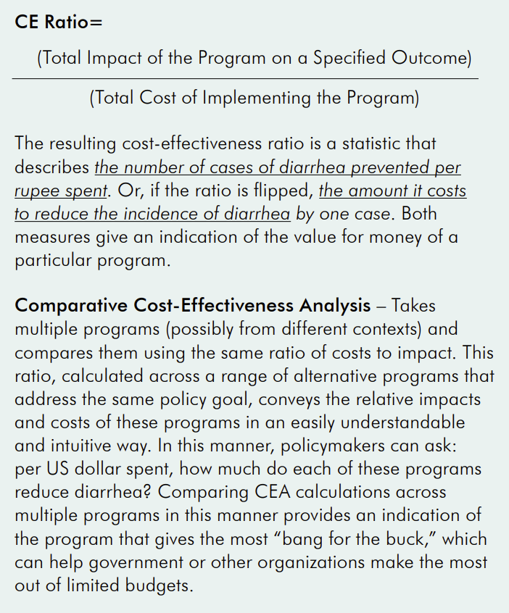
Notes:
https://dmeo.gov.in/sites/default/files/2021-09/Introduction_to_Cost_Effectiveness_Analysis.pdf

Slide 28
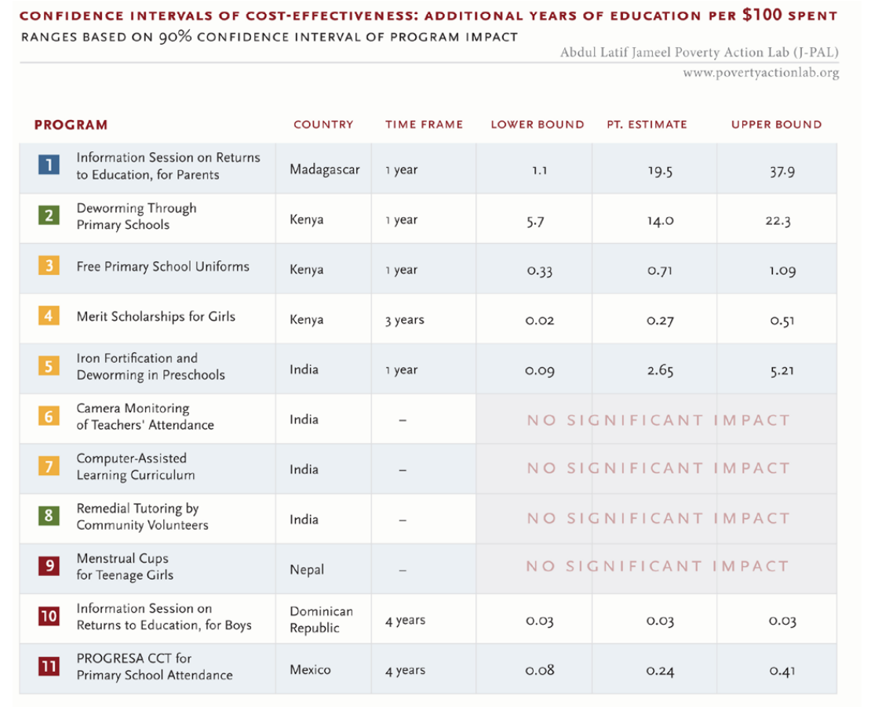
Notes:
https://economics.mit.edu/sites/default/files/2022-08/cost-effectiveness-1.pdf

Slide 29
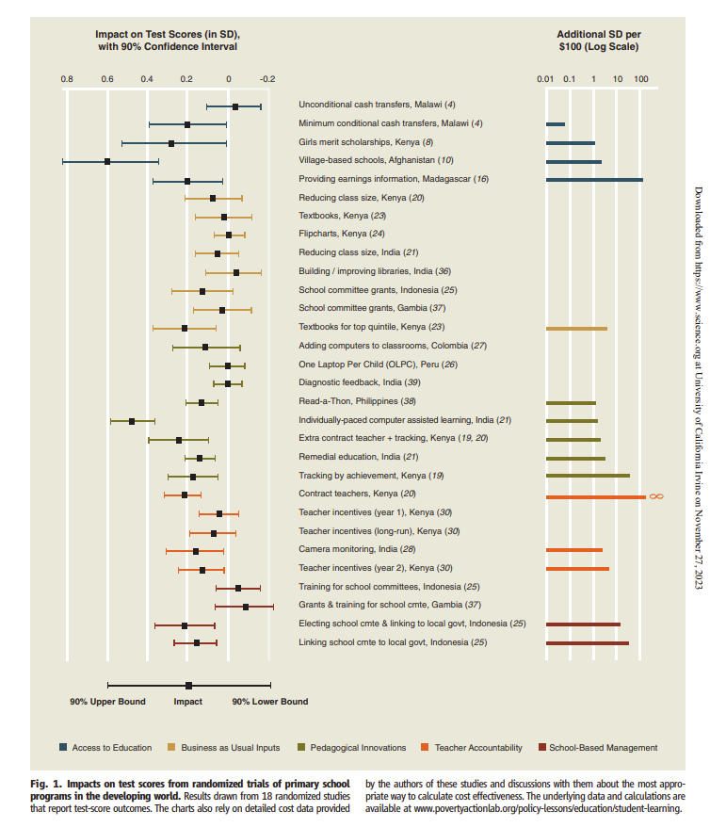
Angrist et al. 2013
Notes:
https://www.science.org/doi/pdf/10.1126/science.1235350

Slide 30
Notes:
https://www.tandfonline.com/doi/full/10.1080/19439342.2022.2034916

Slide 31
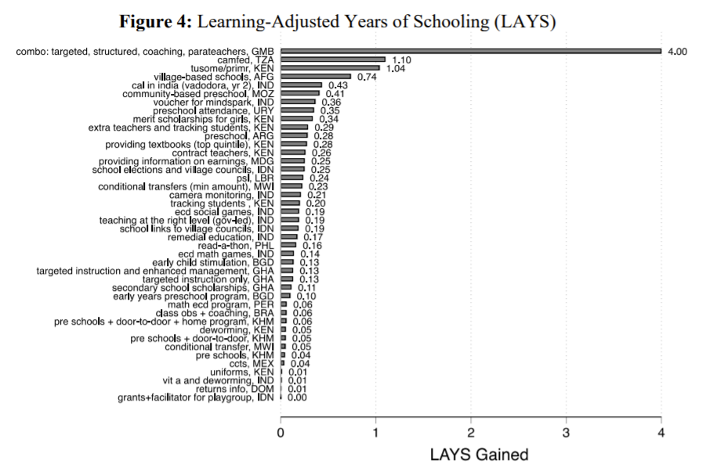
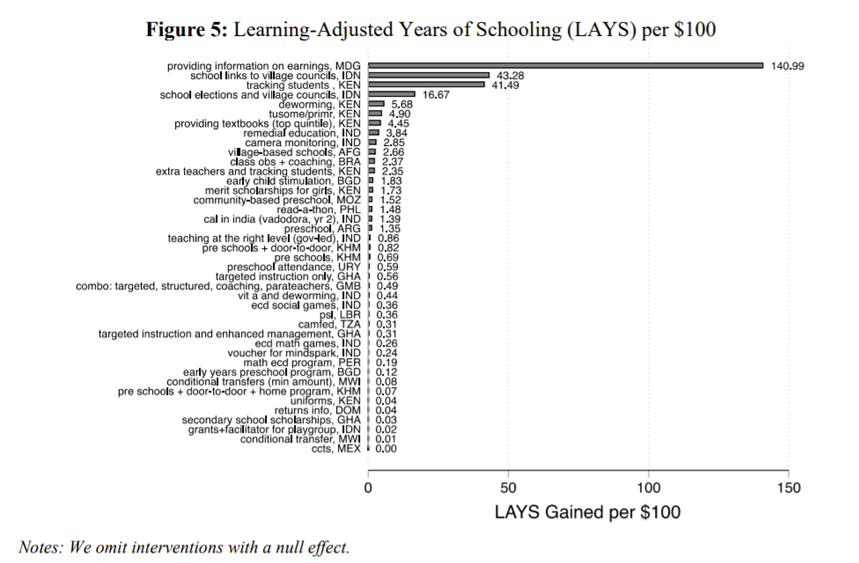
Angrist et al. 2021

Slide 32
Notes:
https://www.tandfonline.com/doi/full/10.1080/19439342.2022.2034916

Slide 33
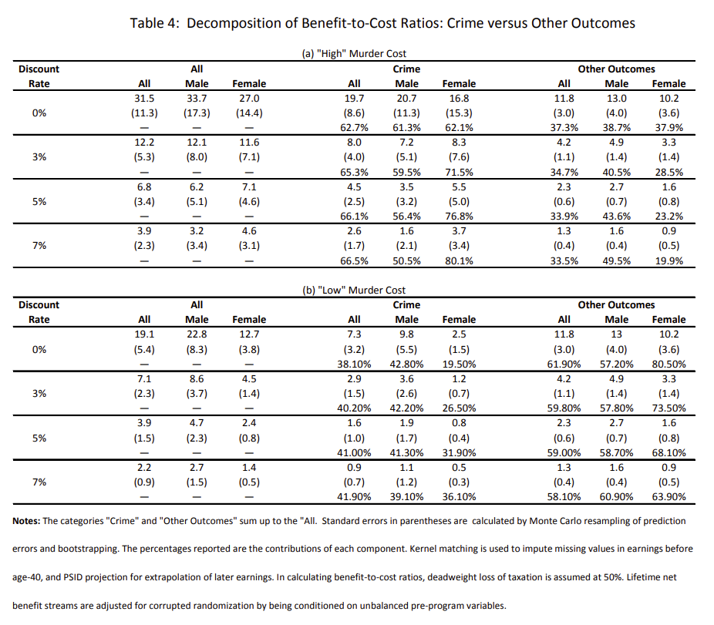
Notes:
https://jenni.uchicago.edu/papers/Heckman_Moon_etal_2010_NBER_wp16180.pdf

Slide 34
The ‘generalizability framework’

Slide 35
Intuition
An intervention worked because it addressed binding constraint “A”. Another context also struggles with the same binding constraint “A”? So, …

Slide 36
The question
How can we identify a mechanism and judge whether this mechanism applies in a new setting?

Slide 38
Four “misguided approaches”
1. A study can only inform policy in the context it was undertaken. “Different culture” 2. Shoddy local results are better than rigorous results from elsewhere. “Local evidence wins” 3. Scale-ups require a (new, local) randomized evaluation. “Evidence chains” 4. Programs / policies need to be replicated x number of times. “More evidence is always better”

Slide 39
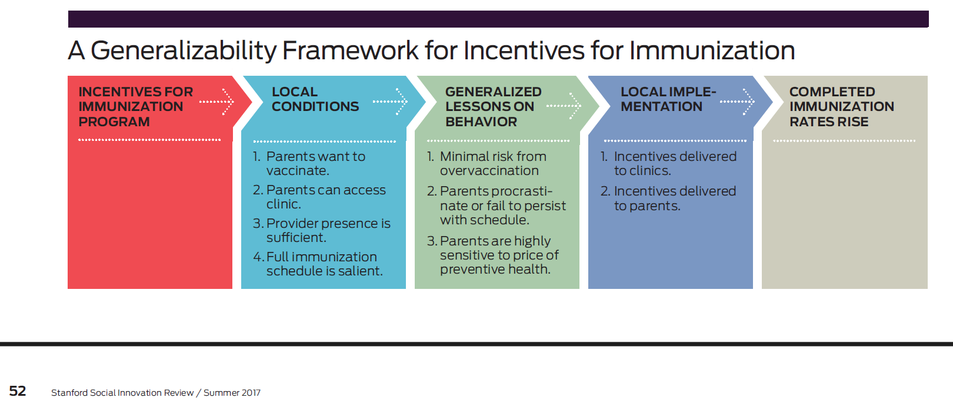

Slide 40
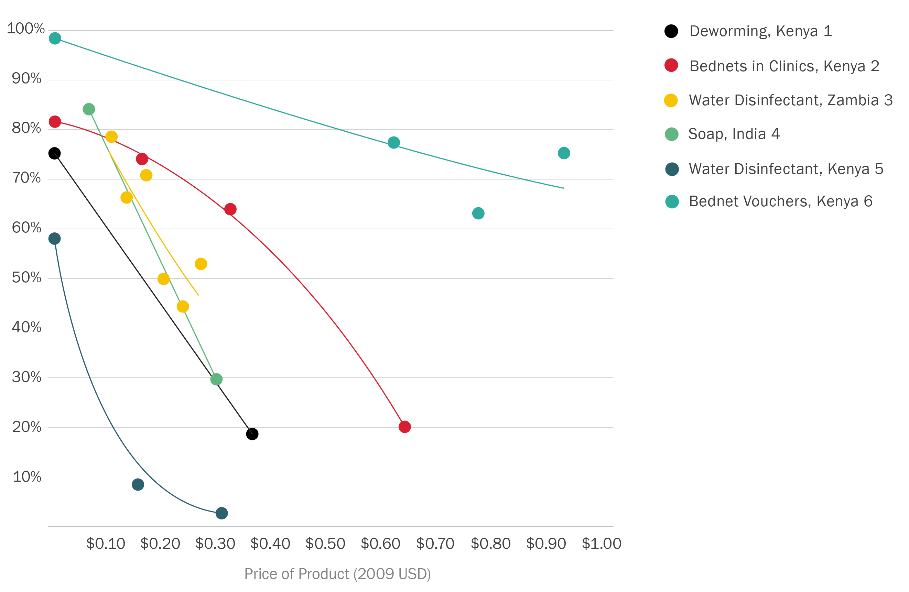
Price sensitivity of preventative health
Source: Kremer and Miguel 2007, Ashraf et al 2010, Spears 2010, Dupas et al in process, & Dupas 2013. All as summarized in J-PAL Policy Bulletin. 2011.

Slide 41



What do these three have in common?
“Mindspark” in India
“Teaching at the Right Level” in Zambia
“Match Education” in Chicago
Notes:
https://www.povertyactionlab.org/evaluation/boosting-academic-performance-through-individualized-tutoring-chicago-public-high https://www.povertyactionlab.org/sites/default/files/publication/Evidence-Review_The-Transformative-Potential-of-Tutoring.pdf

Slide 42
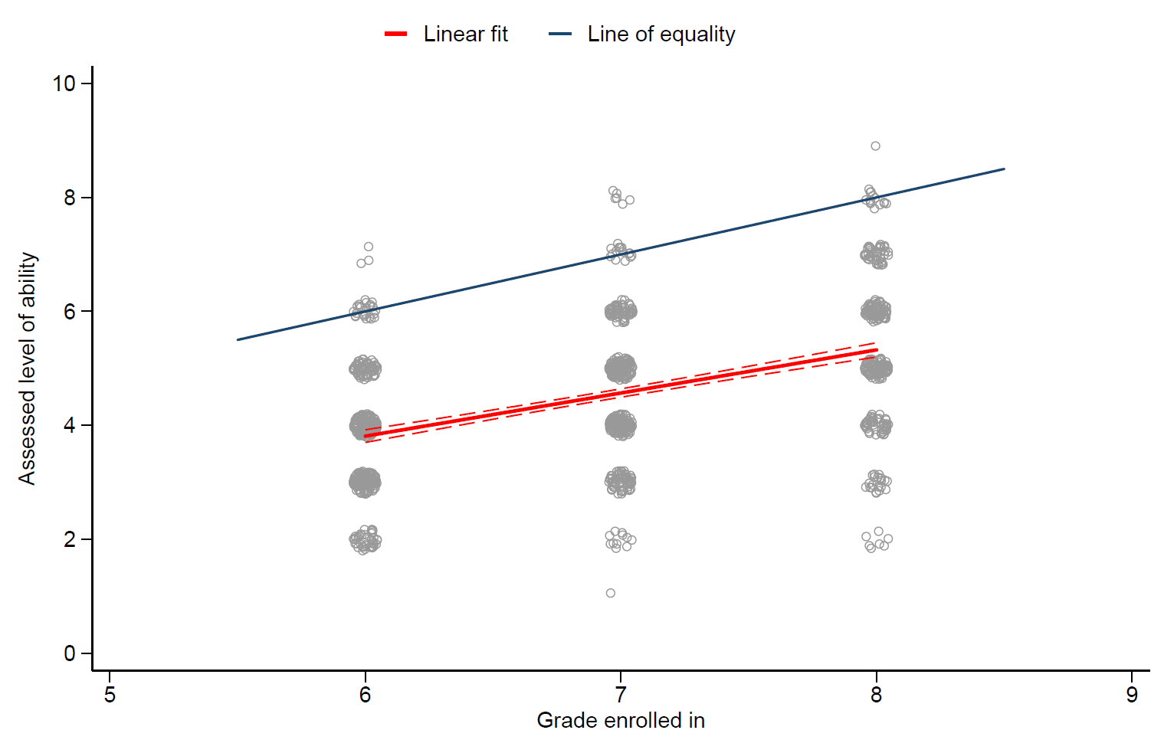
One day in Mindspark
de Barros & Ganimian 2023

Slide 43
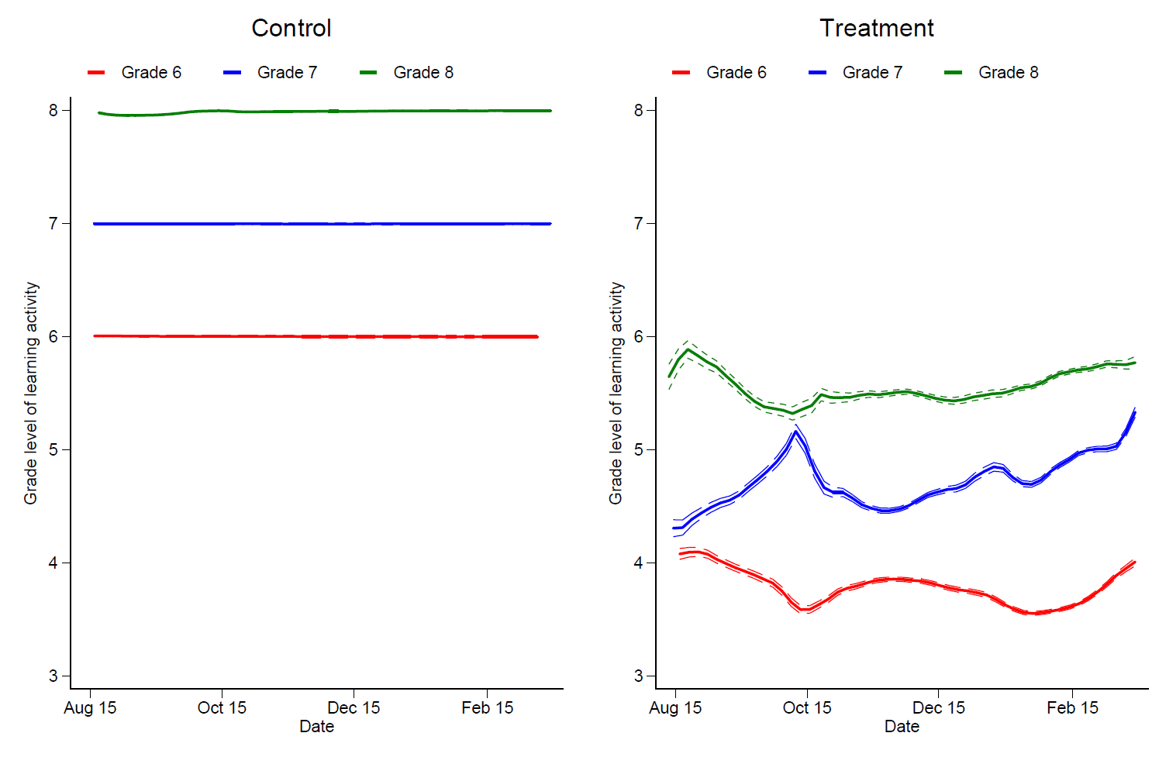
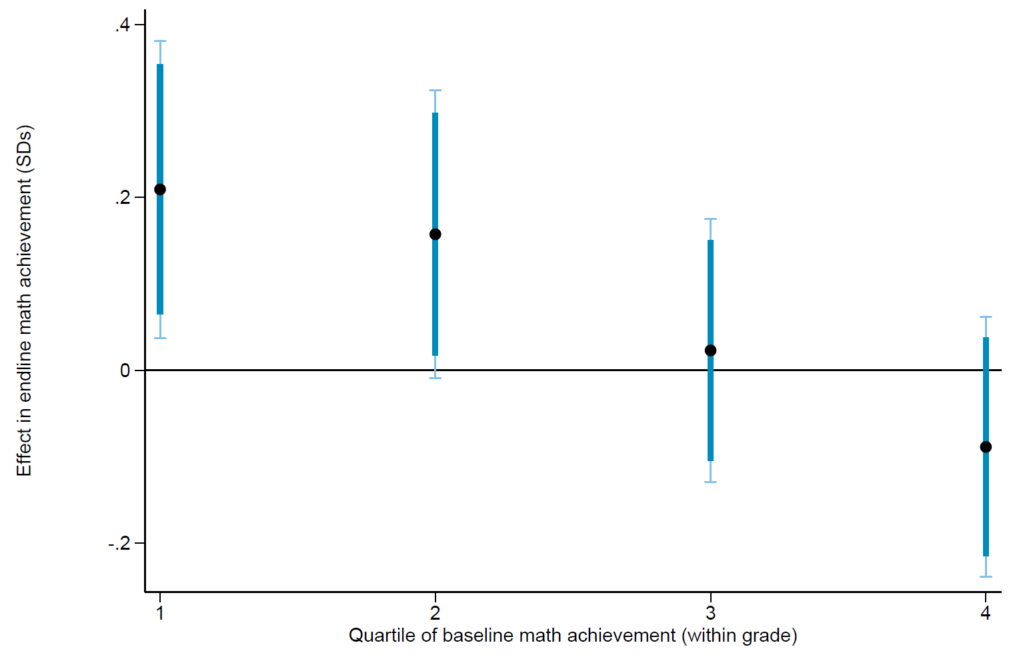
Testing the mechanism
de Barros & Ganimian 2023

Slide 44
Announcements, plan for next classes
Milestone 3
Power calculations are for extra credit only
Student hours on Wednesday
Q&A on Dec 5
Submit questions by Sunday
Exam: Revision on Dec 7

